Slide 1
Lập trình trên Windows với Microsoft® .NET Giảng viên : Hồ Hoàn Kiếm

Slide 2
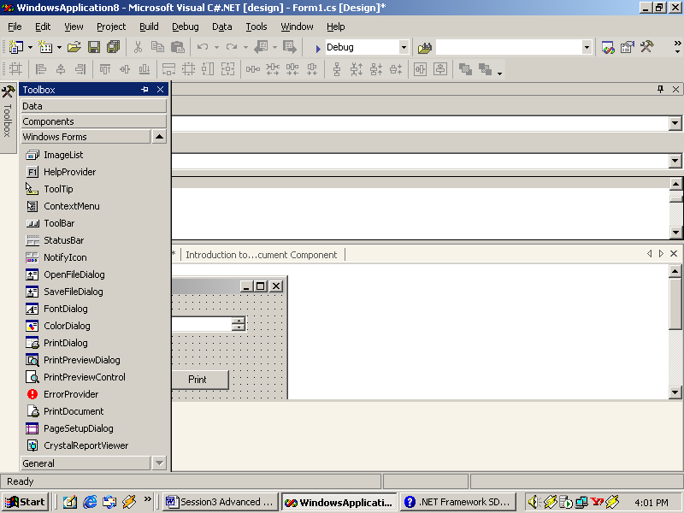
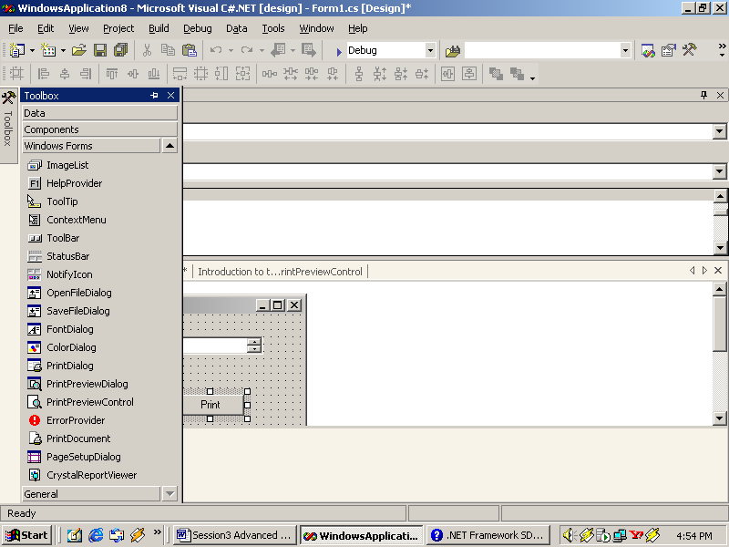
Sử dụng controls trong C#
Printing Support Controls
PrintDocument
PrintPreviewControl

Slide 3
Sử dụng controls trong C#
PrintPreviewControl
PROPERTIES
AutoZoom
Document
Zoom
Columns
UseAntiAlias
Rows
StartPage
Methods
InvalidatePreview

Slide 4

Sử dụng controls trong C#
Dialog Boxes
Uses
To display information and messages for the user
As a means of accepting user-input
Types (by Presentation)
Modal
Modeless

Slide 5
Sử dụng controls trong C#
Dialog Types
Types of Dialog (by definition)
Custom dialog boxes
OpenFileDialog
PageSetUpDialog
FontDialog
ColorDialog
SaveFileDialog
PrintPreviewDialog
PrintDialog
Common dialog boxes

Slide 6
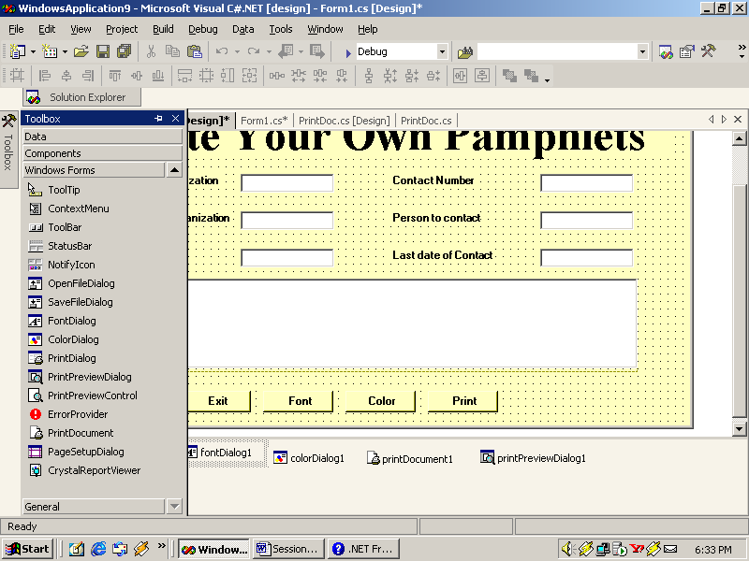
Sử dụng controls trong C#
OpenFileDialog
PROPERTIES
Filter
MutiSelect
ShowReadOnly
ReadOnlyChecked
FileName
ShowHelp
RestoreDirectory
InitialDirectory
FileNames
CheckFileExists
DefaultExt

Slide 7
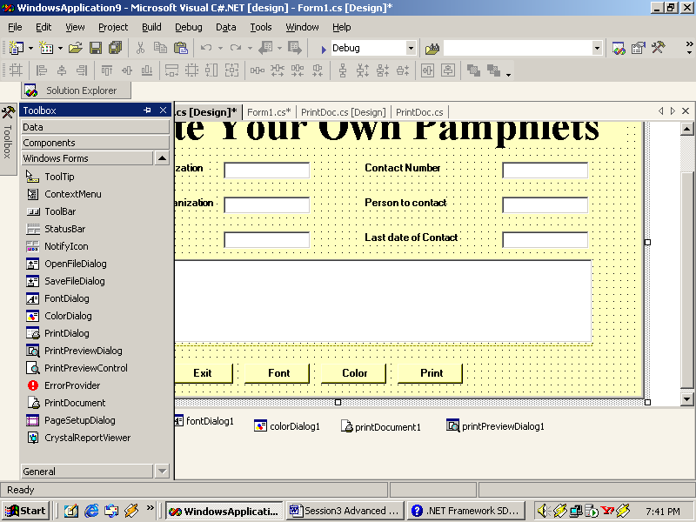
Sử dụng controls trong C#
FontDialog
PROPERTIES
AllowVectorFonts
ShowColor
ShowEffects
AllowVerticalFonts
MinSize
MaxSize
ShowHelp
Color
Font

Slide 8
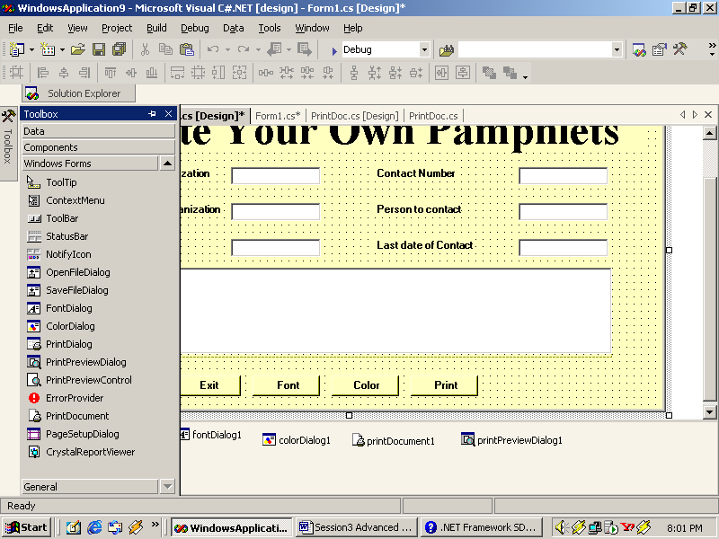
Sử dụng controls trong C#
ColorDialog
PROPERTIES
AllFullOpen
AnyColor
Color
SolidColorOnly
ShowHelp
CustonColors
FullOpen

Slide 9
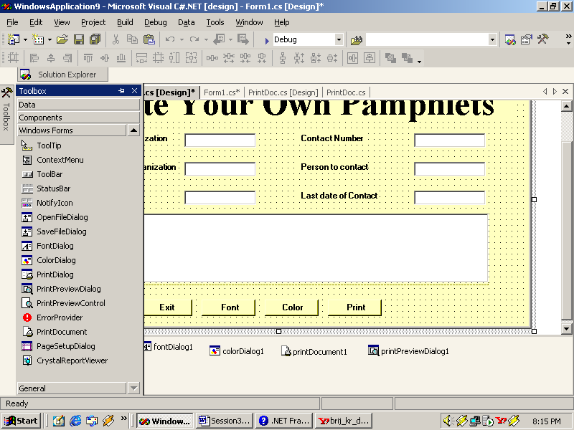
Sử dụng controls trong C#
SaveFileDialog
PROPERTIES
CreatePrompt
Methods
OverwritePrompt
OpenFile

Slide 10
Sử dụng controls trong C#
MessageBox [1]
MessageBox
Code for showing Messagebox:
MessageBox.Show(“[Message]”);
MessageBox method is overloaded in twelve more ways to give more functionality

Slide 11
Sử dụng controls trong C#
MessageBox [2]
MessageBoxButtons
MessageBoxIcon
MessageBoxOptions
MessageBoxDefaultButton

Slide 12
Sử dụng controls trong C#
MessageBoxButton
Member Name
AbortRetryIgnore
OK
OKCancel
RetryCancel
YesNo
YesNoCancel

Slide 13
Sử dụng controls trong C#
MessageBoxIcon
Member Name
Member Name
Asterisk
Question
Error
Stop
Exclamation
Warning
Hand
Information
None

Slide 14
Sử dụng controls trong C#
MessageBoxOptions
Member Name
DefaultDesktopOnly
RightAlign
RtlReading
ServiceNotification

Slide 15
Sử dụng controls trong C#
MessageBoxDefaultButton
Member Name
Button1
Button2
Button3

Slide 16
Sử dụng controls trong C#
Visual Effects in WinForms
Transparent Forms
Control Docking
Control Anchoring
Visual Inheritance

Slide 17
Sử dụng controls trong C#
Transparent Forms
Opacity
this.Opacity = 0.83;

Slide 18
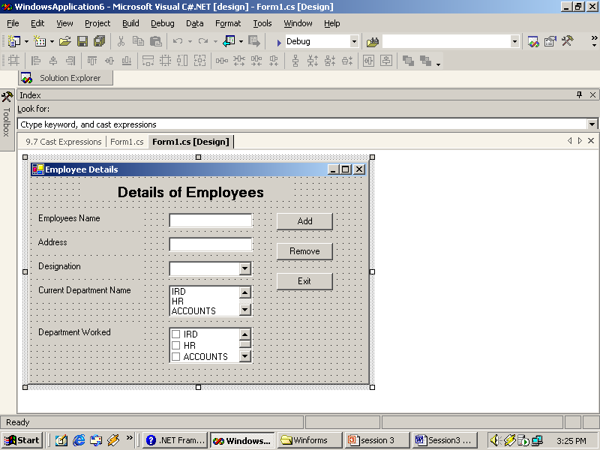
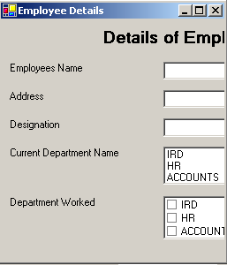
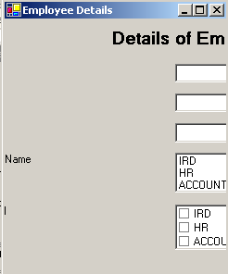
Sử dụng controls trong C#
Control Anchoring
Control Anchored
Control not Anchored

Slide 19
Sử dụng controls trong C#
Visual Inheritance
Visual Inheritance
Creates a base Form
Used at various places
Allows changes to be made in the inherited form

